Slide 1
Funding Flows for CTE & Frequently Asked CLNA Questions

Slide 2
PED - CCRB
CCRB computes LEA awards based on federal formula
CCRB determines total consortia planning amount
CCRB provides percentage allocations for consortia members

Slide 3
Consortia meetings
Consortia sets priorities
Consortia determines pooled expenses (example later)

Slide 4
Consortia Lead
Planning budget is reduced by amount of pooled expenses
Lead documents spending priorities as determined by consortia
LEA planning budgets are established using priorities and needs

Slide 5
LEAs
LEAs establish a planning budget for each school that will receive funds
A large LEA serves as fiscal agent for the consortia lead and oversees the pooled expenses
A small LEA may use a large LEA as a fiscal agent to reduce grant related administrative burden
A small LEA may allocate all expenses to the pooled budget to reduce grant related administrative burden

Slide 6
Consortia Lead
Reviews individual budgets to ensure the vision and priorities are maintained
Submits all individual budgets, plus the pooled budget, to PED
Coordinates with consortia members on pooled efforts
Is reimbursed through an LEA serving as fiscal agent

Slide 7
Planning Budget
Each LEA will have its own budget
LEA budgets can cover none, one, or more than one program
Each LEA can have a “budget common to all” for non-program needs
Each LEA has an opportunity to adjust its budget during the fall budget finalization process

Slide 8
Pooled funds and LEA budgets
Consortia members decide on pooled efforts and allocations of LEA funding.
Pooled funds benefit all consortia members.
LEA | Formula Allocations and Percentages |  | Consortia Allocations Based on Needs and Priorities
District A | $70,000 | 70% | $55,000 | 60%
District B | $25,000 | 25% | $17,000 | 20%
District C | $ 4,000 | 4% | $ 8,000 | 8%
State Charter | $ 1,000 | 1%
Pooled Funds |  |  | $20,000 | 20%

Slide 9
Budget Approval
CCRB issues approval emails
Spending may begin July 1 (or thereafter, when approval is received)
LEAs seek board approval and begin spending anytime after July 1

Slide 10
Federal Ed Department
Federal budget authority is delivered October 1
Changes in award amounts may require budget updates
Budget changes are entered and the consortia lead verifies the consortia vision is maintained
CCRB issues award letters when final budget ties to final award amount

Slide 11
Final Budget
The final budget reflects the vision of the consortia
LEAs can spend up to 90% of their planning budget before the final award letter is received
All funds must be expended by June 30

Slide 12
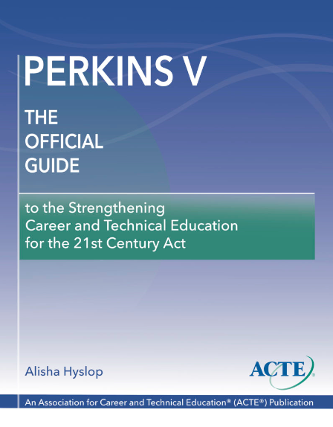
Is the CLNA required to apply for funding?
Yes.
The CLNA is a new requirement established with Perkins V (Section 134) which specifies that in order to be eligible for federal funding, an eligible recipient shall conduct a CLNA related to CTE and include the results in the local application.
CLNA=
Comprehensive Local Needs Assessment

Slide 13
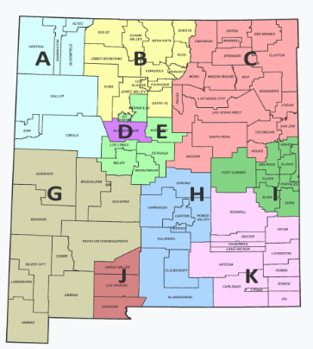
What are the NM CTE regions based on?
The CTE Regions were based on many existing regional structures: Workforce Region, Economic Region, Geographical Areas of Responsibility (GAR), and Regional Education Cooperatives (RECs).
The GAR is the geographic area assigned by the Higher Education Department to a community college in which the college has the responsibility to provide services to constituent school districts.

Slide 14
Can a school be part of more than one CTE Region?
All school districts and state charters have only one CTE Region.
Colleges may be a partner with more than one CTE Region because of their GAR, but most colleges will participate in only one CTE Region.

Slide 15
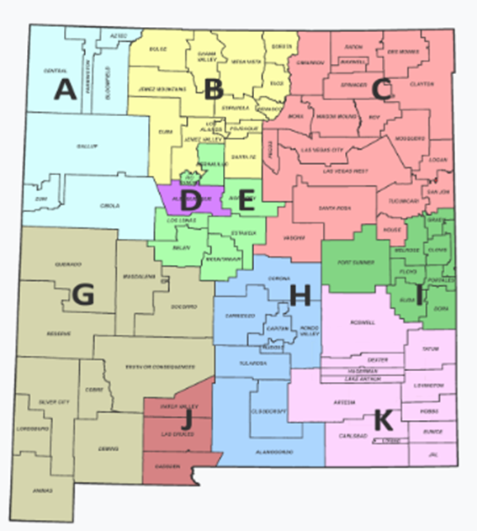
Who are the partners in a CTE Region?
Please reference the required stakeholders who should be engaged at the local level.
Representatives of the required stakeholders would be involved at the regional level as well and may be added as “Potential Partners” through the Online Template Forms http://nmcteclna.com/

Slide 16
Who are the required stakeholders (Section 134(d) of Perkins V)?
LEA CTE program representatives (teachers, counselors, administrators, support personnel)
Postsecondary CTE program representatives (faculty, administration)
State/local workforce development boards, economic development organizations, local/regional business & industry
Parents & students
Representatives of Special Populations (11 identified)
Representatives of regional or local agencies serving out-of-school youth, homeless children, at-risk youth
Representatives of Indian Tribes and Tribal Organizations in the State
Any other stakeholder required by the state, region, or local agencies (RECs)

Slide 17
What are the Special Populations?
Individuals with disabilities;
Individuals from economically disadvantaged families, including low income youth and adults;
Individuals preparing for non-traditional fields;
Single parents, including single pregnant women;
Out-of-work individuals;
English learners;
Homeless individuals described in section 725 of the McKinney-Vento Act;
Youth who are in, or have aged out of, the foster care system;
Youth with a parent who is:
A member of the armed services
Active duty status

Slide 18
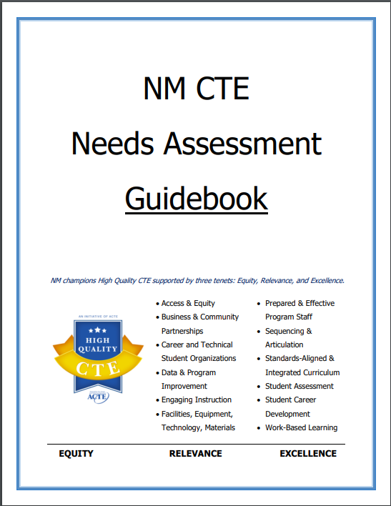
How do we complete the CLNA homework?
The NM CTE CLNA site has both the guidebook and templates for reference to determine the best approach for each school. The district/college should start by understanding the process, regional LMI, and required partners to determine the best approach for the size of the school. Some may divide the templates through a committee approach prior to the designees entering the information into the Online Template Forms, while other smaller schools may meet periodically to enter information into the Online Template Forms collaboratively.
NMCTECLNA.com

Slide 19
Labor Market Information…what if an economic need wasn’t in the LMI?
The Regional LMI will only represent the current needs. If a large employer, potential industry, or economic development need has been identified that is not in your LMI, economic development priorities should be considered for priorities in the region.

Slide 20
Is there a three-year cap on funding a CTE program?
No.
Funded programs should meet the priority needs of the region.
Programs are encouraged to look toward LMI, economic development and innovation; however, this does not translate into an expiration of funding for a vital program for the region.

