Slide 1
New Mexico CTE
Region E
Comprehensive Local Needs Assessment

Slide 2
Introductions
Tracey Bryan, President/CEO
The Bridge of Southern New Mexico
Trevor Stokes, Labor Market Analyst
NS4ed

Slide 3
Guiding Principals for Conversation
To help us have the most collaborative conversation possible, what values/principals should help us guide the discussion?

Slide 4
One Abbreviation We Can Agree On
Career and Technical Education (CTE)
Career and technical education is the practice of teaching specific career skills to students in middle school, high school, and post-secondary institutions.
- Applied Educational Systems
Career and Technical Education provides secondary and post-secondary students with the academic and technical skills and knowledge to prepare for the current and future workforce.
- National Alliance for Partnerships in Equity

Slide 5
OK…One More Abbreviation
CTE
is
STEM
(Science, Technology, Engineering, and Math)

Slide 6
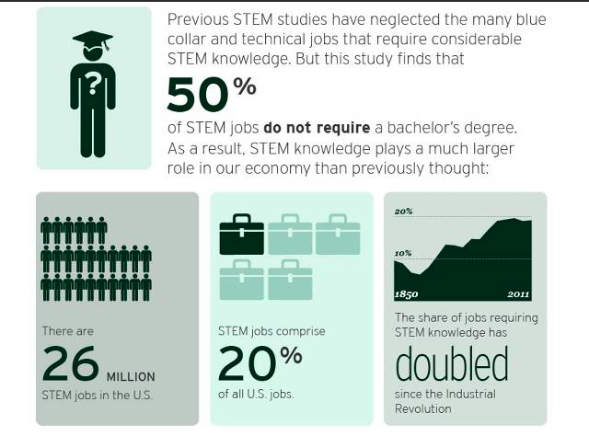
Brookings Institute

Slide 7
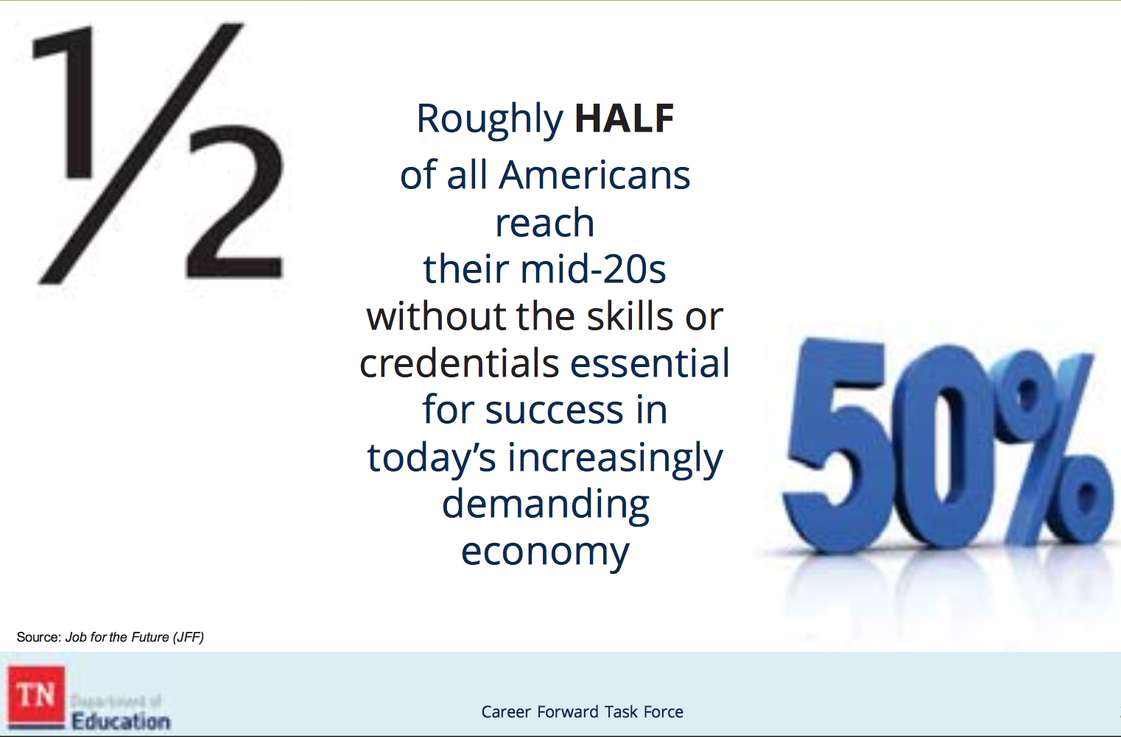
Dangers of not doing the work now…

Slide 8
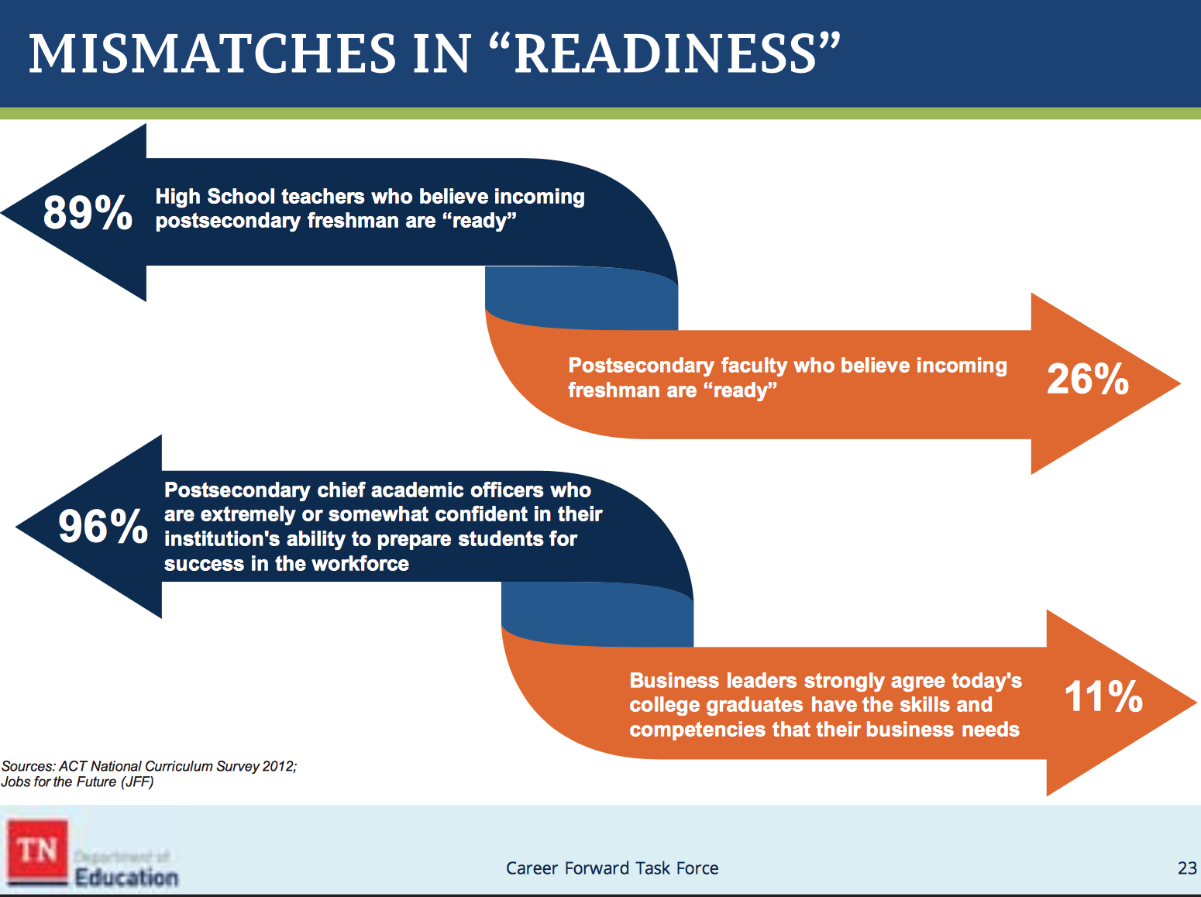
Mismatch will continue to grow…

Slide 9
Benefits of CTE
Source: Association of Career and Technical Education
For Business:
Significantly more likely to develop soft skills
50% STEM jobs require less than a 4-year degree
Aligned to middle-, technical-, and high-skilled jobs, hard-to-fill jobs, and jobs in demand
For the Economy:
Annual economic benefits ($3.5 billion in OK)
Increased contributions to state economy
($5.1 billion in CO)
Returns $26 in lifetime earnings and benefits for every
$1 invested in HS CTE (WA)

Slide 10
Benefits of CTE
Source: Association of Career and Technical Education/NM PED
For High School Students:
Graduate at 94% vs. 71% for non-CTE students
91% with 2-3 CTE credits enroll in college
  58% of NM CTE concentrators go to college, advanced training, military service, or employment within six mo. after graduation
81% of HS dropouts say relevant, real-world opportunities would have kept them in school

Slide 11
Benefits of CTE
Source: Association of Career and Technical Education
For College Students and Adults:
Technical or Associate of Applied Science degrees
out-earn bachelor degree holders by $2,000-$11,000. (Research from TX, CO, VA)
27% of those with licenses or certificates earn more than average bachelor’s degree holder
48% of CTE concentrators earn credentials or diplomas
68% employed, in military service, or apprenticeships in 6 mo. of graduation
64% of all degrees awarded statewide

Slide 12
CTE Matters to New Mexico
(Source: National Alliance for Partnerships in Equity/NM PED
Today:
49% of low-income families have no post-secondary experience
34% of students earn AA/AS degrees in 6 years
45% of students earn BA/BS degrees in 6 years
66% of all high school students are in CTE
54% of all college students are enrolled in CTE and
32% are CTE concentrators

Slide 13
CTE Matters to Your Region
(Source: Fordham Institute Report)
How Aligned is CTE to Local Labor Markets?
Fields that support a significant number of jobs see little CTE course-taking in high school
Students take more related CTE courses when aligned to more local jobs
  80% of Americans lives less than a couple hours drive from home
  Median distance is 18 miles; 44 miles for New Mexico
Call to action:
  Local business, industry, secondary and post-secondary work in a united way
  Better integration of what is taught in HS CTE programs with skills, knowledge, and positions needed in local labor markets through sector strategies that include WBL

Slide 14

16 Career Clusters in CTE

Slide 15
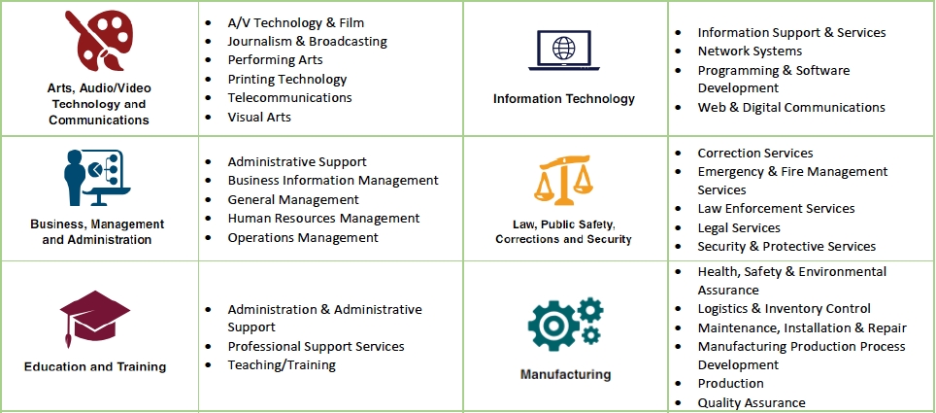
Career Pathways in CTE

Slide 16
Career Pathways in CTE

Slide 17
Career Pathways in CTE

Slide 18
Region E – Perkins Funding
$470,778
School Year 2020-21

Slide 19
Who Can Provide CTE in Region E?
Region E comprises a number of school districts and charter schools:
Belen Consolidated
Bernalillo
Estancia Municipal
Los Lunas
Moriarty
Mountainair
Rio Rancho
State Charter-School of Dreams
State Charter-Robert F Kennedy
Three Colleges:
University of New Mexico
UNM-Valencia
Central New Mexico Community College (CNM)
REC 5

Slide 20
CTE Matters to Workforce Needs
Source: New Mexico Dept. of Workforce Solutions
From Now to 2026:
20% increase in Healthcare & Social Assistance
15% increase in Mining
11% increase in Professional, Scientific, & Technical Assistance
5% increase in Construction
5% increase in Educational Services
5% increase in Transportation & Warehousing

Slide 21
Build NM Industry Sectors
Governor Michelle Lujan Grisham
Target Sectors for a Diversified Economy:
Cybersecurity
Intelligent Manufacturing
Sustainable and Green Industries
Bioscience and Health
Tourism and Outdoor Industries
Digital Media and Film
Sustainable and Value-Added Agriculture
Aerospace

Slide 22
What Does the Labor Market Tell Us?

Slide 23
What Does the Labor Market Tell Us?
Sector/Top Detailed Industries |  | 2019 Jobs | Average Wages | Location Quotient
Government
 | Local Government, Excluding Education and Hospitals | 21,577 | $43,505 | 1.45
 | Education (Local Government) | 20,391 | $35,480 | 0.99
 | Federal Government, Civilian, Excluding Postal Service | 12,837 | $84,420 | 2.16
 | Education (State Government) | 10,903 | $53,434 | 1.53
 | Hospitals (State Government) | 8,464 | $58,148 | 8.62
 | State Government, Excluding Education and Hospitals | 7,072 | $51,061 | 1.20
 | Federal Government, Military | 5,620 | $52,457 | 1.13
 | US Postal Service | 1,563 | $62,381 | 0.99
Health Care and Social Assistance
 | General Medical and Surgical Hospitals | 10,156 | $68,285 | 0.83
 | Services for the Elderly and Persons with Disabilities | 8,125 | $18,814 | 1.61
 | Offices of Physicians | 5,551 | $82,337 | 0.81
 | Home Health Care Services | 4,934 | $25,150 | 1.28
 | Other Outpatient Care Centers | 4,747 | $59,270 | 2.71
 | Child Day Care Services | 3,132 | $23,267 | 1.29
 | Nursing Care Facilities (Skilled Nursing Facilities) | 2,988 | $41,047 | 0.72
 | Offices of Dentists | 2,982 | $48,922 | 1.20
 | Continuing Care Retirement Communities and Assisted Living Facilities for the Elderly | 2,751 | $24,818 | 1.12
 | Medical and Diagnostic Laboratories | 1,785 | $58,887 | 2.48

Slide 24
What Does the Labor Market Tell Us?
Sector/Top Detailed Industries |  | 2019 Jobs | Average Earnings | Location Quotient
Professional, Scientific and Technical
 | Research/Development-Physical, Engineering, Life Science | 13,343 | $104,544 | 7.95
 | Computer Systems Design and Related Services | 3,385 | $71,940 | 0.60
 | Offices of Lawyers | 3,381 | $78,052 | 1.23
 | Engineering Services | 3,204 | $92,322 | 1.24
 | Accounting, Tax Prep, Bookkeeping, and Payroll Services | 2,166 | $51,607 | 0.82
 | Management Consulting Services | 1,418 | $74,242 | 0.44
 | Veterinary Services | 1,088 | $39,425 | 1.06
 | Architectural Services | 628 | $63,524 | 1.25
 | Environmental Consulting Services | 582 | $72,573 | 2.53
 | Research/Development-Social Sciences and Humanities | 554 | $29,067 | 3.34
Administrative and Waste Services
 | Telephone Call Centers | 6,489 | $35,242 | 4.97
 | Temporary Help Services | 4,060 | $28,030 | 0.53
 | Janitorial Services | 2,971 | $15,676 | 1.05
 | Investigation, Guard, and Armored Car Services | 2,756 | $27,698 | 1.32
Construction
 | Electrical Contractors, Wiring Installation Contractors | 4,017 | $56,819 | 1.60
 | Commercial and Institutional Building Construction | 3,580 | $60,139 | 2.02
 | Plumbing, Heating, and Air-Conditioning Contractors | 2,851 | $51,405 | 0.96
 | Residential Building Construction | 2,046 | $48,063 | 0.95
 | Highway, Street, and Bridge Construction | 1,324 | $55,032 | 1.48
 | Water/Sewer Line and Related Structures Construction | 1,186 | $61,476 | 2.35

Slide 25
What Does the Labor Market Tell Us?
Sector/Top Detailed Industries |  | 2019 Jobs | Average Wages | Location Quotient
Manufacturing
 | Semiconductor, Electronic Components | 3,002 | $97,359 | 3.09
 | Navigational…, Electromedical, and Control Instruments | 954 | $81,505 | 0.88
 | Pharmaceutical and Medicine | 651 | $53,127 | 0.84

Slide 26
What Does the Labor Market Tell Us?
The occupation families with the largest projected growth include:
  Government and Government Enterprises
  Health Care and Social Assistance
  Retail Trade
  Accommodation and Food Service
  Professional, Scientific and Technical Services
  Administrative and Waste Management Services
  Construction
  Manufacturing

Slide 27
What Does the Labor Market Tell Us?
High Quality Career | 2016 Jobs | 2026 Jobs | New Jobs | % Change | Annual Openings | Average Earnings
Construction Occupations
Supervisors-Construction and Extraction | 2,229 | 2,736 | 507 | 23% | 324 | $56,965
Construction and Building Inspectors | 180 | 213 | 33 | 18% | 28 | $51,908
Service Unit Operators, Oil, Gas, Mining | 26 | 40 | 14 | 54% | 7 | $70,157
Structural Iron and Steel Workers | 42 | 46 | 4 | 10% | 7 | $57,763
Elevator Installers and Repairers | 89 | 93 | 4 | 4% | 13 | $73,259
Rail-Track Equipment Operators | 41 | 45 | 4 | 10% | 5 | $64,878
Health Care Practitioners and Technical Occupations
Registered Nurses | 9,275 | 10,366 | 1,091 | 12% | 642 | $74,527
Nurse Practitioners | 391 | 511 | 120 | 31% | 36 | $112,198
Physical Therapists | 579 | 678 | 99 | 17% | 37 | $92,847
Speech-Language Pathologists | 391 | 485 | 94 | 24% | 33 | $65,034
Respiratory Therapists | 393 | 481 | 88 | 22% | 33 | $59,740
Physician Assistants | 402 | 484 | 82 | 20% | 33 | $113,077
Dental Hygienists | 483 | 561 | 78 | 16% | 43 | $74,120
Diagnostic Medical Sonographers | 350 | 428 | 78 | 22% | 29 | $65,805
Occupational Health and Safety Specialists | 319 | 377 | 58 | 18% | 26 | $73,800
Occupational Therapists | 341 | 397 | 56 | 16% | 26 | $77,822
Radiologic Technologists | 597 | 642 | 45 | 8% | 39 | $59,920

Slide 28
What Does the Labor Market Tell Us?
High Quality Career | 2016 Jobs | 2026 Jobs | New Jobs | % Change | Annual Openings | Average Earnings
Business and Financial Operations Occupations
Management Analysts | 1,394 | 1,669 | 275 | 20% | 173 | $79,983
Market Analysts & Marketing Specialists | 791 | 999 | 208 | 26% | 114 | $54,887
Logisticians | 332 | 530 | 198 | 60% | 67 | $72,984
Accountants and Auditors | 3,409 | 3,597 | 188 | 6% | 347 | $62,093
Management Occupations
Financial Managers | 1,175 | 1,461 | 286 | 24% | 132 | $92,036
Medical and Health Services Managers | 781 | 988 | 207 | 27% | 91 | $101,984
Construction Managers | 699 | 868 | 169 | 24% | 77 | $118,993
Computer/Information Systems Managers | 513 | 642 | 129 | 25% | 59 | $81,028
Administrative Services Managers | 877 | 999 | 122 | 14% | 92 | $100,352
Social and Community Service Managers | 321 | 415 | 94 | 29% | 43 | $93,471
Architectural and Engineering Managers | 965 | 1,046 | 81 | 8% | 89 | $64,189

Slide 29
What Does the Labor Market Tell Us?
Computer Occupations
Software Developers, Applications | 716 | 964 | 248 | 35% | 84 | $80,720
Computer Systems Analysts | 1,009 | 1,195 | 186 | 18% | 100 | $81,091
Information Security Analysts | 407 | 541 | 134 | 33% | 48 | $104,985
Computer & Information Research Scientists | 270 | 348 | 78 | 29% | 33 | $132,586

Slide 30
What Are Businesses Telling Us?
Region E:
16 Employers in Four Counties
6,460 Employees Collectively
1,584 New Hires Per Year Collectively

Slide 31
What Are Businesses Telling Us?

Slide 32
What Are Businesses Telling Us?

Slide 33
What Are Businesses Telling Us?

Slide 34
What Are Businesses Telling Us?

Slide 35
What Does the Labor Market Tell Us?
A place to start the conversation:
Science, Technology, Engineering, and Math
Business Management
Skilled Construction Trades
Education
21st Century Transportation

Slide 36
How Can We Use These Funds to Build the Next Generation of Talent Here?
Step 1
What’s Our Vision for CTE in Region E?

Slide 37
How Can We Use These Funds to Build the Next Generation of Talent Here?
Step 2
Which Industries Should We Focus On?
Considering:
Potential economic impact
Providing opportunities to grow existing and attract new industries
Offer best connections between students’ education and future career success

Slide 38
How Can We Use These Funds to Build the Next Generation of Talent Here?
Step 3
Who are the partners who can help us achieve our vision?
Considering:
K-12 Districts
Colleges
Workforce Connections
Community Partners

Slide 39
How Can We Use These Funds to Build the Next Generation of Talent Here?
Step 4
What commitments can we make to start the process of achieving our vision?
Considering:
People
Programs
Resources

Slide 40
Next Steps
When we leave the room today, what are we going to do first?

