Slide 1
New Mexico CTE
Region I
Comprehensive Local Needs Assessment

Slide 2
Introductions
Tracey Bryan, President/CEO
The Bridge of Southern New Mexico
Dr. Joseph Goins, President
NS4ed
Trevor Stokes, Labor Market Analyst
NS4ed

Slide 3
Guiding Principals for Conversation
To help us have the most collaborative conversation possible, what values/principals should help us guide the discussion?

Slide 4
One Abbreviation We Can Agree On
Career and Technical Education (CTE)
Career and technical education is the practice of teaching specific career skills to students in middle school, high school, and post-secondary institutions.
- Applied Educational Systems
Career and Technical Education provides secondary and post-secondary students with the academic and technical skills and knowledge to prepare for the current and future workforce.
- National Alliance for Partnerships in Equity

Slide 5
OK…One More Abbreviation
CTE
is
STEM
(Science, Technology, Engineering, and Math)

Slide 6
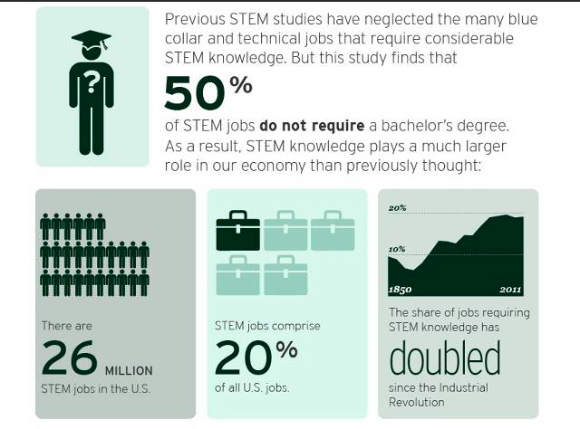
Brookings Institute

Slide 7
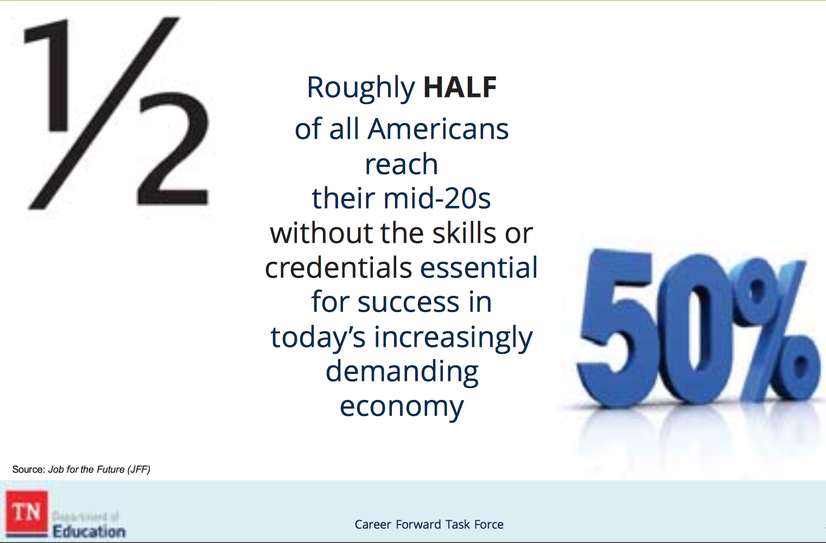
Dangers of not doing the work now…

Slide 8
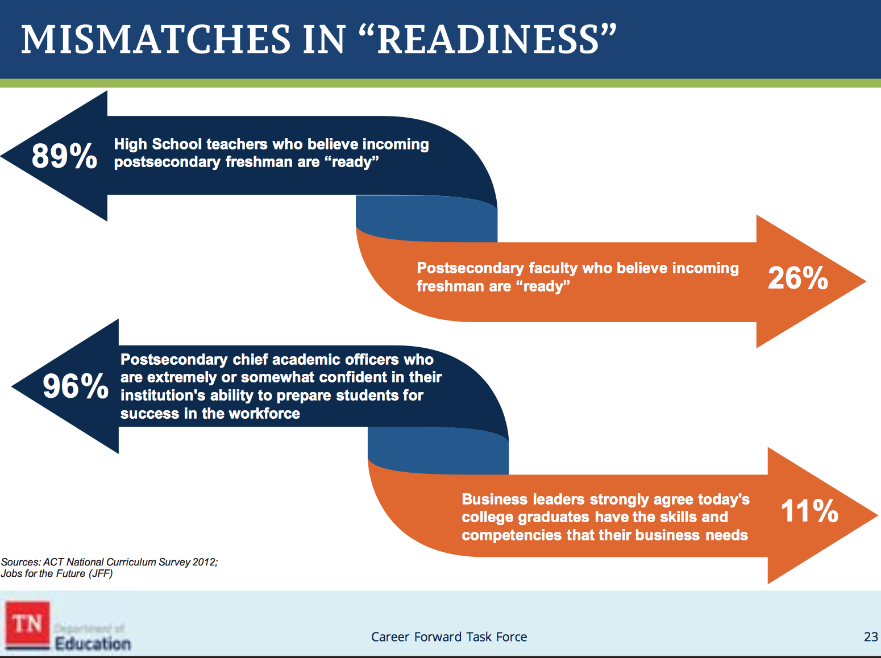
Mismatch will continue to grow…

Slide 9

16 Career Clusters in CTE

Slide 10
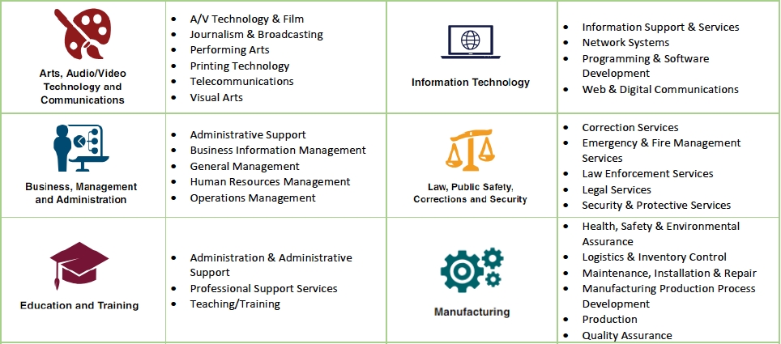
Career Pathways in CTE

Slide 11
Career Pathways in CTE
Which career pathways and clusters seem to be most relevant here?

Slide 12
Benefits of CTE
Source: Association of Career and Technical Education
For Business:
Significantly more likely to develop soft skills
50% STEM jobs require less than a 4-year degree
Aligned to middle-, technical-, and high-skilled jobs, hard-to-fill jobs, and jobs in demand
For the Economy:
Annual economic benefits ($3.5 billion in OK)
Increased contributions to state economy
($5.1 billion in CO)
Returns $26 in lifetime earnings and benefits for every
$1 invested in HS CTE (WA)

Slide 13
Benefits of CTE
Source: Association of Career and Technical Education/NM PED
For High School Students:
Graduate at 94% vs. 71% for non-CTE students
91% with 2-3 CTE credits enroll in college
  58% of NM CTE concentrators go to college, advanced training, military service, or employment within six mo. after graduation
81% of HS dropouts say relevant, real-world opportunities would have kept them in school

Slide 14
Benefits of CTE
Source: Association of Career and Technical Education
For College Students and Adults:
Technical or Associate of Applied Science degrees
out-earn bachelor degree holders by $2,000-$11,000. (Research from TX, CO, VA)
27% of those with licenses or certificates earn more than average bachelor’s degree holder
48% of CTE concentrators earn credentials or diplomas
68% employed, in military service, or apprenticeships in 6 mo. of graduation
64% of all degrees awarded statewide

Slide 15
CTE Matters to New Mexico
(Source: National Alliance for Partnerships in Equity/NM PED
Today:
49% of low-income families have no post-secondary experience
34% of students earn AA/AS degrees in 6 years
45% of students earn BA/BS degrees in 6 years
66% of all high school students are in CTE
54% of all college students are enrolled in CTE and
32% are CTE concentrators

Slide 16
CTE Matters to Your Region
(Source: Fordham Institute Report)
How Aligned is CTE to Local Labor Markets?
Fields that support a significant number of jobs see little CTE course-taking in high school
Students take more related CTE courses when aligned to more local jobs
  80% of Americans lives less than a couple hours drive from home
  Median distance is 18 miles; 44 miles for New Mexico
Call to action:
  Local business, industry, secondary and post-secondary work in a united way
  Better integration of what is taught in HS CTE programs with skills, knowledge, and positions needed in local labor markets through sector strategies that include WBL

Slide 17
CTE Matters to Workforce Needs
Source: New Mexico Dept. of Workforce Solutions
From Now to 2026:
20% increase in Healthcare & Social Assistance
15% increase in Mining
11% increase in Professional, Scientific, & Technical Assistance
5% increase in Construction
5% increase in Educational Services
5% increase in Transportation & Warehousing

Slide 18
Build NM Industry Sectors
Governor Michelle Lujan Grisham
Target Sectors for a Diversified Economy:
Cybersecurity
Intelligent Manufacturing
Sustainable and Green Industries
Bioscience and Health
Tourism and Outdoor Industries
Digital Media and Film
Sustainable and Value-Added Agriculture
Aerospace

Slide 19
Career Pathways in CTE

Slide 20
Career Pathways in CTE

Slide 21
Region I – Perkins Funding
$364,277
School Year 2020-21

Slide 22
Who Can Provide CTE in Region I?
Region I comprises a number of school districts and charter schools:
Clovis Municipal
Dora Consolidated
Elida Municipal
Floyd Municipal
Fort Sumner Municipal
Grady Municipal
Melrose
Portales Municipal
Texico Municipal
Two Colleges:
Eastern New Mexico University
Clovis Community College
REC 6

Slide 23
What Does the Labor Market Tell Us?

Slide 24
What Does the Labor Market Tell Us?
Sector/Top Detailed Industries |  | 2019 Jobs | Average Wages | Location Quotient
Government
 | Federal Government, Military | 5,107 | $62,487 | 13.60
 | Education (Local Government) | 2,448 | $34,193 | 1.57
 | Education (State Government) | 962 | $32,056 | 1.78
 | Local Government, Excluding Education and Hospitals | 930 | $38,932 | 0.83
Health Care and Social Assistance
 | Home Health Care Services | 623 | $17,584 | 2.13
 | General Medical and Surgical Hospitals | 542 | $80,953 | .58
 | Services for the Elderly and Persons with Disabilities | 313 | $16,366 | .82
 | Nursing Care Facilities (Skilled Nursing Facilities) | 301 | $32,526 | .96
 | Vocational Rehabilitation Services | 275 | $27,125 | 4.16
Agriculture, Forestry, Fishing and Hunting
 | Animal Production | 2,188 | $36,795 | 42.24
 | Support Activities for Crop Production | 295 | $39,510 | 3.06
 | Crop Production | 66 | $38,379 | .62
 | Support Activities for Animal Production | 54 | $37,804 | 8.93

Slide 25
What Does the Labor Market Tell Us?
Sector/Top Detailed Industries |  | 2019 Jobs | Average Earnings | Location Quotient
Manufacturing
 | Dairy Product (except Frozen) Manufacturing | 622 | $51,068 | 24.73
 | Snack Food Manufacturing | 122 | $23,953 | 10.65
 | Animal Food Manufacturing | 85 | $47,649 | 6.88
 | Breweries | 50 | $16,072 | 3.08
 | Agricultural Implement Manufacturing | 49 | $53,850 | 3.14
 | Coating, Engraving, Heat Treating, and Allied Activities | 39 | $60,281 | 1.42
 | Forging and Stamping | 36 | $20,254 | 1.80
Construction
 | Commercial and Institutional Building Construction | 165 | $40,809 | 1.23
 | Electrical Contractors and Other Wiring Installation Contractors | 158 | $43,684 | 0.83
 | Plumbing, Heating, and Air-Conditioning Contractors | 128 | $38,100 | 0.57
 | Residential Building Construction | 118 | $24,484 | 0.72
 | Poured Concrete Foundation and Structure Contractors | 107 | $45,600 | 2.37
 | Highway, Street, and Bridge Construction | 75 | $66,564 | 1.10

Slide 26
What Does the Labor Market Tell Us?
Transportation and Warehousing
Rail Transportation | 377 | $98,595 | 8.60
Specialized Freight (except Used Goods) Trucking, Long-Distance | 285 | $52,643 | 10.49
Specialized Freight (except Used Goods) Trucking, Local | 130 | $43,529 | 2.88
General Freight Trucking, Long-Distance | 103 | $48,343 | 0.67

Slide 27
What Does the Labor Market Tell Us?
The occupation families with the largest projected growth include:
  Food Preparation and Serving Occupations (354 new jobs)
  Business and Financial Operations (249)
  Transportation and Material Moving (202)
  Health Care Practitioners and Technical (195)
  Personal Care and Service Occupations (182)
  Community and Social Service Occupations (114)
  Production Occupations (103)

Slide 28
What Does the Labor Market Tell Us?
High Quality Career | 2016 Jobs | 2026 Jobs | New Jobs | % Change | Annual Openings | Average Earnings
Health Care Practitioners and Technical Occupations
Registered Nurses | 427 | 500 | 73 | 17% | 33 | $67,750
Nurse Practitioners | 18 | 28 | 10 | 56% | 2 | $114,645
Radiologic Technologists | 40 | 48 | 8 | 20% | 3 | $53,212
Licensed Practical and Licensed Vocational Nurses | 80 | 86 | 6 | 8% | 7 | $49,548
Physical Therapists | 27 | 34 | 7 | 26% | 2 | $97,092
Surgical Technologists | 19 | 26 | 7 | 37% | 3 | $42,710
Clinical Laboratory Technologists and Technicians | 49 | 56 | 7 | 14% | 5 | $44,181
Business and Financial Operations
Logisticians | 46 | 218 | 172 | 374% | 34 | $75,102
Human Resources Specialists | 121 | 147 | 26 | 21% | 16 | $46,230
Management Analysts | 28 | 36 | 8 | 29% | 4 | $62,348
Financial Analysts | 28 | 31 | 3 | 11% | 3 | $133,119
Accountants and Auditors | 84 | 86 | 2 | 2% | 9 | $53,231
Credit Analysts | 11 | 12 | 1 | 9% | 1 | $51,588
Transportation and Material Moving
Airline Pilots, Copilots, and Flight Engineers | 99 | 120 | 21 | 21% | 14 | $132,438
Air Traffic Controllers | 29 | 33 | 4 | 14% | 3 | $84,389

Slide 29
What Does the Labor Market Tell Us?
High Quality Career | 2016 Jobs | 2026 Jobs | New Jobs | % Change | Annual Openings | Average Earnings
Management
Medical and Health Services Managers | 48 | 63 | 15 | 31% | 6 | $91,598
Financial Managers | 40 | 48 | 8 | 20% | 4 | $83,805
Human Resources Managers | 71 | 78 | 7 | 10% | 7 | $98,742
Education Administrators | 54 | 60 | 6 | 11% | 6 | $82,956
Industrial Production Managers | 13 | 18 | 5 | 38% | 2 | $95,227
Social and Community Service Managers | 16 | 21 | 5 | 31% | 2 | $58,453
Computer and Information Systems Managers | 21 | 23 | 2 | 10% | 2 | $89,156
Installation, Maintenance and Repair
Aircraft Mechanics and Service Technicians | 187 | 192 | 5 | 3% | 18 | $58,842
Industrial Machinery Mechanics | 90 | 103 | 13 | 14% | 10 | $57,584
Supervisors-Mechanics, Installers, and Repairers | 135 | 137 | 2 | 1% | 13 | $61,938
Electronics Repairers, Commercial and Industrial | 39 | 49 | 10 | 26% | 5 | $51,256
Mobile Heavy Equipment Mechanics | 39 | 45 | 6 | 15% | 5 | $54,735
Education, Training and Library Occupations
Secondary School Teachers | 177 | 192 | 15 | 8% | 16 | $54,643
Elementary School Teachers | 293 | 308 | 15 | 5% | 26 | $49,524
Middle School Teachers | 182 | 184 | 2 | 1% | 15 | $54,888

Slide 30
What Does the Labor Market Tell Us?
Architecture and Engineering
Computer Hardware Engineers | 18 | 21 | 3 | 17% | 2 | $77,236
Civil Engineers | 27 | 30 | 3 | 11% | 3 | $83,616
Engineering Technicians | 11 | 13 | 2 | 18% | 2 | $63,532
Computer Occupations
Computer User Support Specialists | 78 | 88 | 10 | 13% | 8 | $41,820
Computer Systems Analysts | 19 | 23 | 4 | 21% | 2 | $84,609
Software Developers, Applications | 11 | 13 | 2 | 18% | 1 | $81,327

Slide 31
What Are Businesses Telling Us?

Slide 32
What Are Businesses Telling Us?

Slide 33
What Are Businesses Telling Us?

Slide 34
Region I’s Employers

Slide 35
How Can We Use These Funds to Build the Next Generation of Talent Here?
Step 1
What’s Our Vision for CTE in Region I?

Slide 36
How Can We Use These Funds to Build the Next Generation of Talent Here?
Step 2
Which Industries Should We Focus On?
Considering:
Potential economic impact
Providing opportunities to grow existing and attract new industries
Offer best connections between students’ education and future career success

Slide 37
What Does the Labor Market Tell Us?
A place to start the conversation:
Education
21st Century Transportation
Installation Maintenance and Repair
Skilled Construction Trades
Healthcare Practitioners and Technical Occupations

Slide 38
How Can We Use These Funds to Build the Next Generation of Talent Here?
Step 3
Who are the partners who can help us achieve our vision?
Considering:
K-12 Districts
Colleges
Workforce Connections
Community Partners

Slide 39
How Can We Use These Funds to Build the Next Generation of Talent Here?
Step 4
What commitments can we make to start the process of achieving our vision?
Considering:
People
Programs
Resources

Slide 40
Next Steps
When we leave the room today, what are we going to do first?

