Slide 1
New Mexico CTE
Region J
Comprehensive Local Needs Assessment

Slide 2
Introductions
Tracey Bryan, President/CEO
The Bridge of Southern New Mexico
Dr. Joseph Goins, President
NS4ed
Trevor Stokes, Labor Market Analyst
NS4ed

Slide 3
Guiding Principals for Conversation
To help us have the most collaborative conversation possible, what values/principals should help us guide the discussion?

Slide 4
One Abbreviation We Can Agree On
Career and Technical Education (CTE)
Career and technical education is the practice of teaching specific career skills to students in middle school, high school, and post-secondary institutions.
- Applied Educational Systems
Career and Technical Education provides secondary and post-secondary students with the academic and technical skills and knowledge to prepare for the current and future workforce.
- National Alliance for Partnerships in Equity

Slide 5
OK…One More Abbreviation
CTE
is
STEM
(Science, Technology, Engineering, and Math)

Slide 6
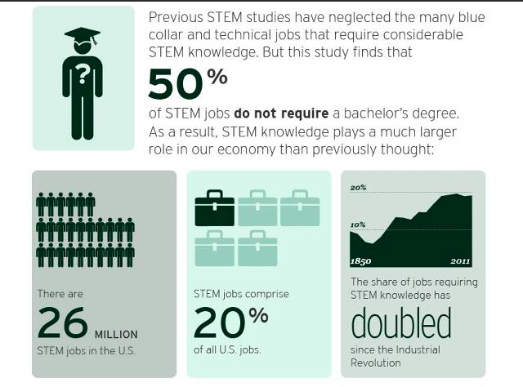
Brookings Institute

Slide 7
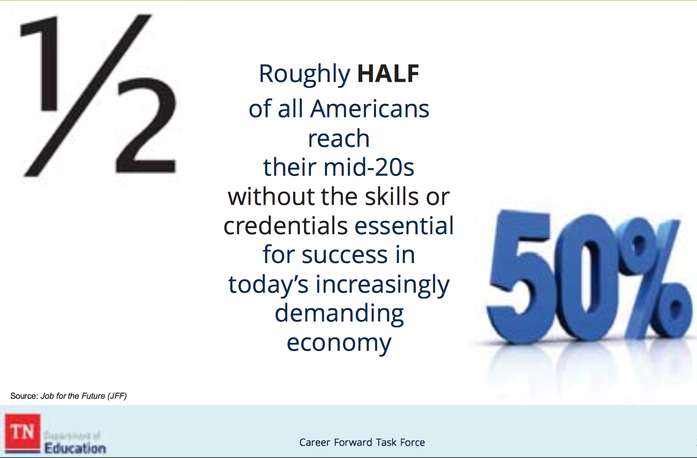
Dangers of not doing the work now…

Slide 8
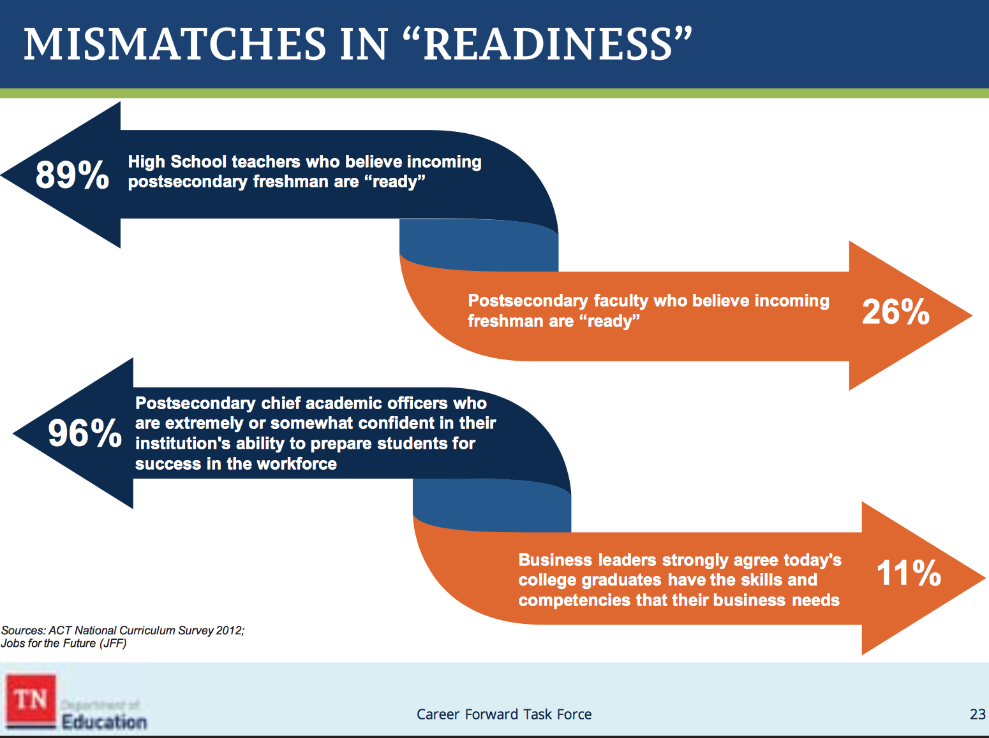
Mismatch will continue to grow…

Slide 9
Benefits of CTE
Source: Association of Career and Technical Education
For Business:
Significantly more likely to develop soft skills
50% STEM jobs require less than a 4-year degree
Aligned to middle-, technical-, and high-skilled jobs, hard-to-fill jobs, and jobs in demand
For the Economy:
Annual economic benefits ($3.5 billion in OK)
Increased contributions to state economy
($5.1 billion in CO)
Returns $26 in lifetime earnings and benefits for every
$1 invested in HS CTE (WA)

Slide 10
Benefits of CTE
Source: Association of Career and Technical Education/NM PED
For High School Students:
Graduate at 94% vs. 71% for non-CTE students
91% with 2-3 CTE credits enroll in college
  58% of NM CTE concentrators go to college, advanced training, military service, or employment within six mo. after graduation
81% of HS dropouts say relevant, real-world opportunities would have kept them in school

Slide 11
Benefits of CTE
Source: Association of Career and Technical Education
For College Students and Adults:
Technical or Associate of Applied Science degrees
out-earn bachelor degree holders by $2,000-$11,000. (Research from TX, CO, VA)
27% of those with licenses or certificates earn more than average bachelor’s degree holder
48% of CTE concentrators earn credentials or diplomas
68% employed, in military service, or apprenticeships in 6 mo. of graduation
64% of all degrees awarded statewide

Slide 12
CTE Matters to New Mexico
(Source: National Alliance for Partnerships in Equity/NM PED
Today:
49% of low-income families have no post-secondary experience
34% of students earn AA/AS degrees in 6 years
45% of students earn BA/BS degrees in 6 years
66% of all high school students are in CTE
54% of all college students are enrolled in CTE and
32% are CTE concentrators

Slide 13
CTE Matters to Your Region
(Source: Fordham Institute Report)
How Aligned is CTE to Local Labor Markets?
Fields that support a significant number of jobs see little CTE course-taking in high school
Students take more related CTE courses when aligned to more local jobs
  80% of Americans lives less than a couple hours drive from home
  Median distance is 18 miles; 44 miles for New Mexico
Call to action:
  Local business, industry, secondary and post-secondary work in a united way
  Better integration of what is taught in HS CTE programs with skills, knowledge, and positions needed in local labor markets through sector strategies that include WBL

Slide 14

16 Career Clusters in CTE

Slide 15
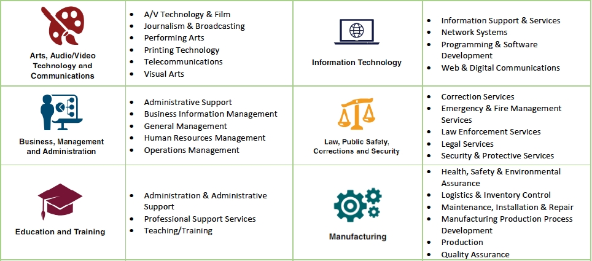
Career Pathways in CTE

Slide 16
Career Pathways in CTE

Slide 17
Career Pathways in CTE

Slide 18
Region G – Perkins Funding
$1,144,201
School Year 2020-21

Slide 19
Who Can Provide CTE in Region G?
Region J comprises a number of school districts and charter schools:
Gadsden Independent
Hatch Valley
Las Cruces
Public Schools
State Charter-
Las Montañas
Two Colleges:
New Mexico State University
NMSU – Dona Ana Community College
REC 10

Slide 20
CTE Matters to Workforce Needs
Source: New Mexico Dept. of Workforce Solutions
From Now to 2026:
20% increase in Healthcare & Social Assistance
15% increase in Mining
11% increase in Professional, Scientific, & Technical Assistance
5% increase in Construction
5% increase in Educational Services
5% increase in Transportation & Warehousing

Slide 21
Build NM Industry Sectors
Governor Michelle Lujan Grisham
Target Sectors for a Diversified Economy:
Cybersecurity
Intelligent Manufacturing
Sustainable and Green Industries
Bioscience and Health
Tourism and Outdoor Industries
Digital Media and Film
Sustainable and Value-Added Agriculture
Aerospace

Slide 22
What Does the Labor Market Tell Us?

Slide 23
What Does the Labor Market Tell Us?
Sector/Top Detailed Industries |  | 2019 Jobs | Average Wages | Location Quotient
Government
 | Education (Local Government) | 5,973 | $40,241 | 1.37
 | Education (State Government) | 5,502 | $35,364 | 3.63
 | Local Government, Excluding Education and Hospitals | 3,968 | $42,360 | 1.26
 | Federal Government, Civilian, Excluding Postal Service | 3,516 | $92,692 | 2.79
Health Care and Social Assistance
 | Home Health Care Services | 2,896 | $16,022 | 3.53
 | Services for the Elderly and Persons with Disabilities | 2,641 | $17,333 | 2.47
 | General Medical and Surgical Hospitals | 2,562 | $58,589 | 0.98
 | Offices of Physicians | 1,872 | $68,678 | 1.29
 | Child Day Care Services | 884 | $20,656 | 1.72
 | Nursing Care Facilities (Skilled Nursing Facilities) | 790 | $33,591 | 0.90

Slide 24
What Does the Labor Market Tell Us?
Construction
 | Residential Building Construction | 599 | $39,946 | 1.31
 | Plumbing, Heating, and Air-Conditioning Contractors | 594 | $42,164 | 0.94
 | Electrical Contractors and Other Wiring Installation Contractors | 509 | $40,067 | 0.95
 | Site Preparation Contractors | 397 | $44,163 | 2.02
 | Commercial and Institutional Building Construction | 358 | $45,596 | 0.95
 | Other Heavy and Civil Engineering Construction | 256 | $55,987 | 3.81
Agriculture, Forestry, Fishing and Hunting
 | Support Activities for Crop Production | 1,809 | $23,175 | 6.68
 | Crop Production | 1,670 | $28,340 | 5.57
 | Animal Production | 476 | $31,174 | 3.27

Slide 25
What Does the Labor Market Tell Us?
Professional, Scientific and Technical Services
 | Computer Systems Design and Related Services | 767 | $59,899 | 0.64
 | Engineering Services | 745 | $71,983 | 1.36
 | Testing Laboratories | 381 | $61,511 | 3.97
 | Accounting, Tax Preparation, Bookkeeping, and Payroll Services | 287 | $36,729 | 0.51
 | Offices of Lawyers | 268 | $53,199 | 0.46
 | Research-Development-Physical, Engineering, and Life Sciences | 248 | $91,019 | 0.70
Manufacturing
 | Fruit and Vegetable Canning, Pickling, and Drying | 480 | $31,226 | 10.65
 | Aerospace Product and Parts | 292 | $110,652 | 1.02
 | Navigational…, Electromedical, and Control Instruments | 290 | $63,296 | 1.27
 | All Other Wood Products | 191 | $29,092 | 5.06
 | Seasoning and Dressing | 189 | $39,570 | 8.02

Slide 26
What Does the Labor Market Tell Us?
The occupation families with the largest projected growth include:
  Personal Care and Service Occupations (1,423 new jobs)
  Health Care Practitioners and Technical (913)
  Health Care Support (777)
  Transportation and Material Moving (559)
  Office and Administrative Support (501)
  Management (330)

Slide 27
What Does the Labor Market Tell Us?
High Quality Career | 2016 Jobs | 2026 Jobs | New Jobs | % Change | Annual Openings | Average Earnings
Health Care Practitioners and Technical Occupations
Registered Nurses | 1,489 | 1,859 | 370 | 25% | 124 | $66,411
Physical Therapists | 147 | 244 | 97 | 66% | 18 | $99,311
Speech-Language Pathologists | 106 | 184 | 78 | 74% | 15 | $81,080
Licensed Practical and Licensed Vocational Nurses | 214 | 284 | 70 | 33% | 26 | $46,752
Nurse Practitioners | 103 | 157 | 54 | 52% | 13 | $121,893
Occupational Therapists | 62 | 106 | 44 | 71% | 9 | $99,316
Radiologic Technologists | 163 | 191 | 28 | 17% | 13 | $56,231
Respiratory Therapists | 63 | 91 | 28 | 44% | 7 | $49,150
Surgical Technologists | 70 | 86 | 16 | 23% | 8 | $55,253
Physician Assistants | 34 | 49 | 15 | 44% | 4 | $126,677

Slide 28
What Does the Labor Market Tell Us?
Office and Administrative Support
Supervisors-Office and Administrative Support | 848 | 948 | 100 | 12% | 108 | $44,586
Human Resources Assistants | 78 | 70 | (8) | (10%) | 8 | $36,786
Management
Medical and Health Services Managers | 129 | 175 | 46 | 36% | 16 | $94,219
Financial Managers | 139 | 170 | 31 | 22% | 15 | $87,667
Computer and Information Systems Managers | 78 | 98 | 20 | 26% | 9 | $94,804
Education Administrators | 184 | 201 | 17 | 9% | 18 | $90,174

Slide 29
What Does the Labor Market Tell Us?
Business and Financial Operations
Human Resources Specialists | 193 | 254 | 61 | 32% | 29 | $45,586
Market Research Analysts and Specialists | 115 | 174 | 59 | 51% | 21 | $50,268
Management Analysts | 147 | 183 | 36 | 24% | 19 | $67,501
Logisticians | 39 | 66 | 27 | 69% | 8 | $69,916
Compliance Officers | 168 | 187 | 19 | 11% | 18 | $81,309
Accountants and Auditors | 446 | 454 | 8 | 2% | 44 | $52,407
Computer Occupations
Software Developers, Applications | 125 | 185 | 60 | 48% | 17 | $60,275
Software Developers, Systems Software | 407 | 452 | 45 | 11% | 38 | $89,846
Computer Systems Analysts | 149 | 184 | 35 | 23% | 16 | $67,739
Network and Computer Systems Administrators | 128 | 140 | 12 | 9% | 11 | $65,293
Computer Network Support Specialists | 130 | 141 | 11 | 8% | 13 | $50,981
Operations Research Analysts | 121 | 131 | 10 | 8% | 10 | $95,234

Slide 30
What Does the Labor Market Tell Us?
Construction
Operating Engineers, Equipment Operators | 231 | 295 | 64 | 28% | 38 | $38,923
Supervisors-Construction Trades and Extraction | 297 | 324 | 27 | 9% | 36 | $52,661
Carpenters | 254 | 276 | 22 | 9% | 31 | $37,792
Plumbers, Pipefitters, and Steamfitters | 207 | 207 | 0 | 0% | 25 | $49,634
Production
Supervisors-Production and Operating Workers | 190 | 203 | 13 | 7% | 22 | $51,688
Welders, Cutters, Solderers, and Brazers | 124 | 136 | 12 | 10% | 16 | $43,803
Power Plant Operators | 22 | 29 | 7 | 32% | 3 | $74,743
Aircraft Structure…, Rigging, Systems Assemblers | 24 | 26 | 2 | 8% | 2 | $109,380

Slide 31
What Are Businesses Telling Us?

Slide 32
What Are Businesses Telling Us?

Slide 33
What Are Businesses Telling Us?

Slide 34
What Does the Labor Market Tell Us?
A place to start the conversation:
Healthcare
Business Management
Computer Occupations
Public Administration
Transportation and Warehousing

Slide 35
How Can We Use These Funds to Build the Next Generation of Talent Here?
Step 1
What’s Our Vision for CTE in Region J?

Slide 36
How Can We Use These Funds to Build the Next Generation of Talent Here?
Step 2
Which Industries Should We Focus On?
Considering:
Potential economic impact
Providing opportunities to grow existing and attract new industries
Offer best connections between students’ education and future career success

Slide 37
How Can We Use These Funds to Build the Next Generation of Talent Here?
Step 3
Who are the partners who can help us achieve our vision?
Considering:
K-12 Districts
Colleges
Workforce Connections
Community Partners

Slide 38
How Can We Use These Funds to Build the Next Generation of Talent Here?
Step 4
What commitments can we make to start the process of achieving our vision?
Considering:
People
Programs
Resources

Slide 39
Next Steps
When we leave the room today, what are we going to do first?

