Slide 1
Using the CTE Grant Management Site: Next Gen CTE Perkins V
N
W
E
S
College and Career Readiness Bureau

Slide 2
Available CTE Funding
Perkins V (aka “Federal funding”)
Funding determined by formula
Funding is over-weighted for community poverty
Local Needs determine what is fundable
Aligned Programs of Study are required
Most funds tied to POS
Next Gen CTE (aka “State funding”)
Funding determined by formula
Funding is over-weighted for community poverty
Local Needs required for 50% of funding
LEA choice available for 50% of funding
Funds not necessarily tied to POS

Slide 3
SCORE NO MORE
Beginning in 2020, the old Perkins application site, known as SCORE, will no longer be used for Perkins applications…

Slide 4
A new CTE Grant Management Site is available for LEAs to apply for CTE funding
The first step to obtain access is to Request an account

Slide 5
When you have requested credentials and have been approved, your LEA name will appear on all pages of the application…

Slide 6
Two Year Cycle
To support strategic development of CTE programs, the main components of the CTE application will only be updated every other year. The budget will continue to be updated annually.

Slide 7
Icons on the left facilitate navigating to the different components of the application. The Application Summary provides a quick status report for what still needs to be completed.

Slide 8
The Narrative asks seven questions to guide LEAs through the key considerations for building a quality application. Both Next Gen and Perkins require high-quality CTE programming.
NOTICE: Pay special attention to the need to SAVE frequently, especially before moving to another application page. There is no auto-save feature in the application- unsaved work will be lost if you change your page view.

Slide 9
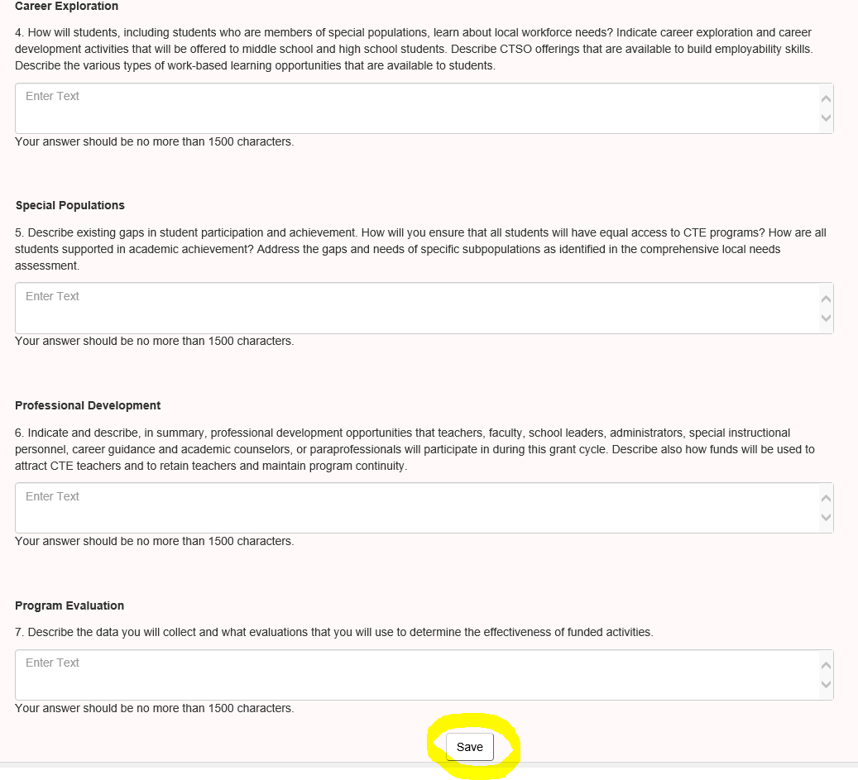
All narrative statements should be answered to provide a complete explanation of your CTE programming.
NOTICE: SAVE buttons are on the top and bottom of most application pages.

Slide 10
Programs of Study (POS)
Perkins
All funding requires that the consortia offer POS that are aligned with the priorities of the local area
Most funds should be used for POS support
Pooled funds allow the consortia to address broader regional needs
Next Gen
50% of funding may be used in support of the locally identified priorities
50% of funds may be used in support of the LEA identified priorities
Funds do not require a POS

Slide 11
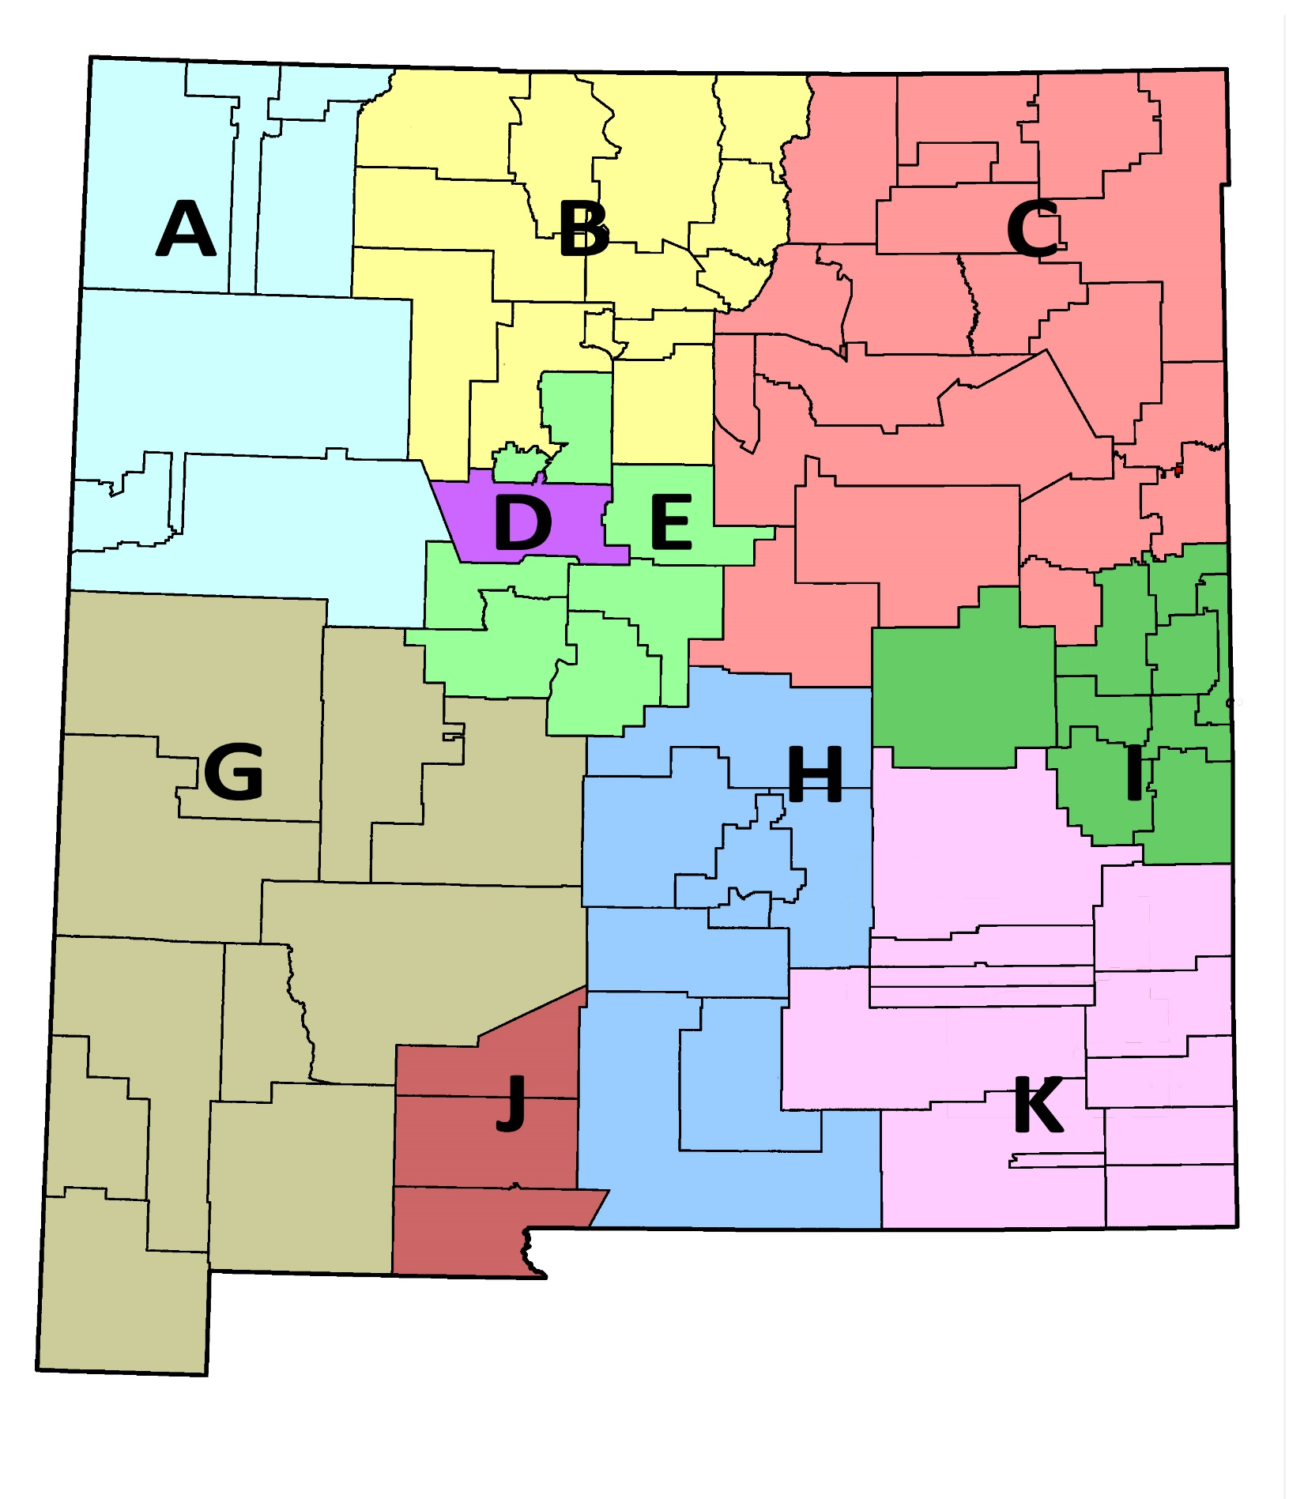
Comprehensive Local Needs Assessment (CLNA)
Regionally defined priorities
Tie to WIOA priorities
Available POS are determined by the priorities identified in the CLNA
LEAs select from the POS that are available
Some Next Gen funding does not require CLNA alignment

Slide 12
Available programs of study are pre-populated. LEA selects from available choices in the dropdown list.
The available POS are determined by the priorities of the local needs assessment and are set at the consortium level.
Available POS appear in the dropdown.
Half of the LEAs available Next Gen CTE funding may be used to support non-priority programs. Use the “Other-LEA Choice” program to add a Next Gen Budget.

Slide 13
The LEA will provide details for their specific POS.
Once on the POS page, select the View/Edit hyperlink to modify all POS required fields (except budget).

Slide 14
5 information tabs are required for each POS.
NOTICE: Pathway Partnerships and Program Requirements have the most fields that require input- be sure to check them all.

Slide 15
In the Pathway Partnerships tab, select participating LEA high schools and ONE postsecondary partner.
NOTICE: If your LEA only has one high school, only one high school will be available in the dropdown. Also, only select your primary postsecondary partner even if you have more than one.

Slide 16
The Programs of Study tab is informational. The content is prepopulated.
NOTICE: If your program is offering certifications which are not shown in the table, inform your CCRB Coach.

Slide 17
In the Program Requirements tab, you must Select and Add one or more of your LEA high schools.
NOTICE: As you add the high school(s), and required courses for the student to complete the POS, they will populate in the table below the dropdown menus.

Slide 18
The Career Area Course/College Entrance Requirements section is asking you to populate your LEA course sequence for the POS, based on available courses that can be used for that POS
NOTICE: The Post-secondary Program Course Sequence table has been prepopulated and requires no input or changes from the applicants.

Slide 19
The CTE Programs/Program of Study Alignment page requires applicant input.
NOTICE: The course sequence offered specifically within your LEA is now viewable in the table as mentioned previously.

Slide 20
The Strategic Alignment tab is completed by the Consortia Lead. Please familiarize yourself with the prompts.
The responses required for these prompts for description of program alignment from secondary to employment and for the question about instructor preparation may shift to the applicant in the future.

Slide 21
The Programs of Study Budget page features unique links for each POS budget, plus a narrative prompt to explain how priorities are being addressed.
NOTICE: The top table indicates the total amount currently allocated from the consortium for ALL programs of study for the LEA.

Slide 22
The Budget Details view is for a specific POS budget for the LEA; in this example, Aerospace Engineering – SREB.
NOTICE: There are both Federal and State budget fields on this page. Work with your CTE coach to determine what expenses are best suited to the two different funding sources.

Slide 23
The Common to All Programs of Study budget is accessible from the POS Budget List and is displayed regardless of which specific budget is viewed.
NOTICE: In the Explanation Federal column of the Travel row, only a partial view is available of the input that has been entered in this text field. It is necessary to scroll through the field to read the entire entry.

Slide 24
An important goal of funding is program growth. Funding Enrollment Goals are set in this section.
Post Secondary Applicants
NOTICE: The LEA can choose the baseline year. Talk with your CTE coach about appropriate targets for new programs.

Slide 25
Secondary programs also need to set enrollment goals.
Secondary Applicants
NOTICE: Many of the fields on the secondary page will be prepopulated with STARS data. You will only need to input your projections for program growth/contraction for 2020 through 2022.

Slide 26
This section contains the new Perkins V Performance Indicators.
The targets will be established as data are available. Secondary and postsecondary have different goals, shown her are secondary goals.
While Next Gen CTE LEA choice funding does not require performance measures, LEAs will be required to submit a short year-end report.

Slide 27
The Assurances letter verifies that the LEA will adhere to all fiscal and program requirements.
The process remains the same too as it was in SCORE, but now there is a much better auto-tabulating Budget Summary.
Perkins recipients can accept the Perkins performance targets by checking the box, or can establish alternative targets using another process.

Slide 28
All funded programs of study will be listed in this table.
NOTICE: These budget fields will be auto-populated based on your budget amounts for each program of study.

Slide 29
The Print Application menu generates a complete application packet for easy recordkeeping.
NOTICE: All sub-menus and tabs that have entries will be included in the print version AND in the export version which is an Acrobat-.pdf file.

Slide 30
Thank you for your diligence and interest in the new Grant Management Site for CTE!
Marc Duske, Special Projects Manager
marc.duske@state.nm.us
College and Career Readiness Bureau
Public Education Department
State of New Mexico
(505) 827-6712
NOTICE: Please feel free to contact me, or your region’s CTE coach, with questions or difficulties you experience with the GMS and/or the application.

